Slide 1
Unit Testing
Mar, 2017

Slide 2
CONTENTS
Overview
Oriented Unit Testing
Requirements Base Testing
Test Case
Test Code Coverage
Google C++ Testing Framework

Slide 3
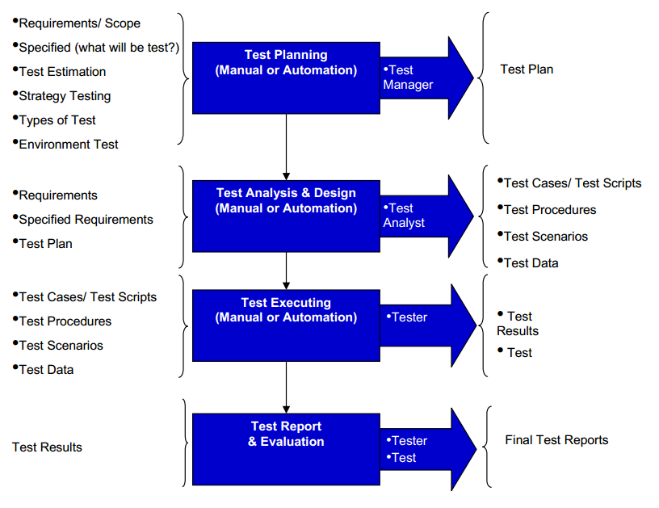
I. OVERVIEW
Software testing workflow

Slide 4
I. OVERVIEW
Unit Test: test units/components - classes, structs, procedures, methods,...
Sends a specific input to a method and verifies method returns expected value.
Purpose: validate each unit performs as designed.

Slide 5
II. ORIENTED UNIT TESTING
Create unit tests when object design is completed.
Focus on execution coverage first.
Keep testing at unit level.
Keep unit tests small and fast.

Slide 6
II. ORIENTED UNIT TESTING
Keep all test cases independently executed.
Make unit tests simple to run.
Cover boundary cases for function test.

Slide 7
III. REQUIREMENTS BASED TESTING
Design Test Cases
Execute Tests
Verify Test Results

Slide 8
III. REQUIREMENTS BASED TESTING
Verify Test Coverage
Must have knowledge of coding and program design.
The technique used is white-box testing

Slide 9
IV. TEST CASE
Test cases includes: test suite name, test case name, data setup, the inputs, expected outcomes.
Ex: TEST(MyTestSuitName, MyTestCaseName) { int actual = 1; EXPECT_GT(actual, 0); EXPECT_EQ(1, actual) << "Should be equal to one"; }

Slide 10
IV. TEST CASE
Should test only one thing.
Short and run fast.
Ensure 100% Coverage.
Avoid test case repetition.

Slide 11
IV. TEST CASE
Work independent of other tests.
Not dependent on the order of their execution.
Positive and negative scenarios are covered.

Slide 12
IV. TEST CASE
Accurate - exacts the purpose.
Economical - no unnecessary steps.
Repeatable, reusable - keeps on going.
Traceable - to a requirement.
Appropriate - for test environment, testers.

Slide 13
V. TEST CODE COVERAGE
Find code is not executed by the test suite.
Coverage measurement formula:
Coverage = Number of coverage items exercised / Total number of coverage items *100%.

Slide 14
V. TEST CODE COVERAGE
Criteria:
Function coverage
Statement coverage
Decision coverage (Branch coverage)
Condition coverage
Path coverage
Notes:
Criteria:
Function coverage: each function in the program been executed or not.
Statement coverage: each line of the source code been executed or not.
Decision coverage (also known as Branch coverage): each control structure such as an if statement has been evaluated both to true and false.
Condition coverage: each boolean sub-expression has been evaluated for both true and false.
Path coverage: every possible route through a given part of the code been executed or not.
Entry/exit coverage: every possible call and return of the function been executed or not

Slide 15
V. TEST CODE COVERAGE
Reference Tools:
OpenCppCoverage: https://opencppcoverage.codeplex.com/
Gcov: http://gcovr.com/guide.html#_overview
TestwellCTC++: http://www.testwell.fi/ctcdesc.html
CoverageMeter: http://www.coveragemeter.com/
BullseyeCoverage: http://www.bullseye.com/
TestCocoon: http://www.testcocoon.org/

Slide 16
V. TEST CODE COVERAGE
OpenCppCoverage Tool
Open source support C++ under Windows
Simple, easy to use.
Line coverage.
Can see percent/total of covered and uncovered lines count.
HTML reporting.
Exclude specific modules/sources.
Non intrusive

Slide 17
OpenCppCoverage tool
V. TEST CODE COVERAGE
1. Download and install: http://opencppcoverage.codeplex.com/
2. Change Debug Information:
Set “Program Database (/Zi)” in “C/C++” item
Set “Yes(/DEBUG)” in “Debugging” item

Slide 18
V. TEST CODE COVERAGE
OpenCppCoverage Tool
4. Build Application
5. Open command line with administrator
[Path]OpenCppCoverage.exe --sources=sourceDir --export_type=html:pathExport --excluded_sources=pathExcluded [Path]xxx.exe

Slide 19

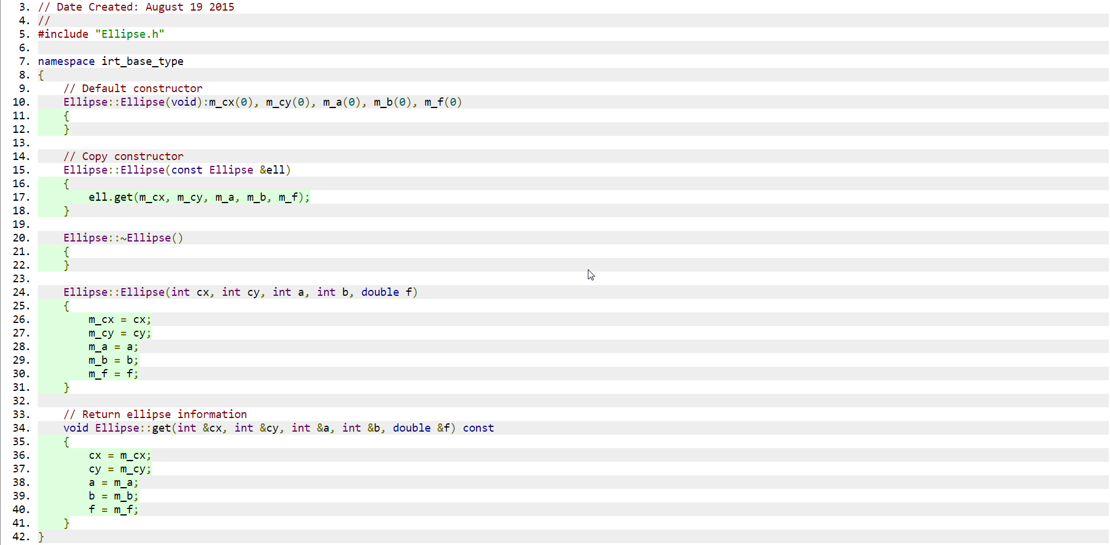
V. TEST CODE COVERAGE
OpenCppCoverage Tool
View report:

Slide 20
V. TEST CODE COVERAGE
On Linux: Gcov
Works only on code complied with GCC
Compile program with two special GCC options: ‘-fprofile-arcs -ftest-coverage’.
Collect code coverage data and generate plain text coverage report

Slide 21
V. TEST CODE COVERAGE
On Linux: Lcov
A graphical front-end for Gcov.
Supports statement, function and branch coverage measurement.
HTML based output.
Reference Link:
https://github.com/linux-test-project/lcov

Slide 22
V. TEST CODE COVERAGE
Gcov tool
1. Install lcov : sudo apt-get install lcov
2. Add more lines to configuration in Makefile
run: $(PROJECT_NAME) ./bin/linux32/release/$(PROJECT_NAME) lcov --capture --directory ./ --output-file coverage.infolcov --remove coverage.info '/usr/include/*' '/usr/lib/*' -o coverageFiltered.info genhtml coverageFiltered.info --output-directory lcov/html xdg-open lcov/html/index.html

Slide 23
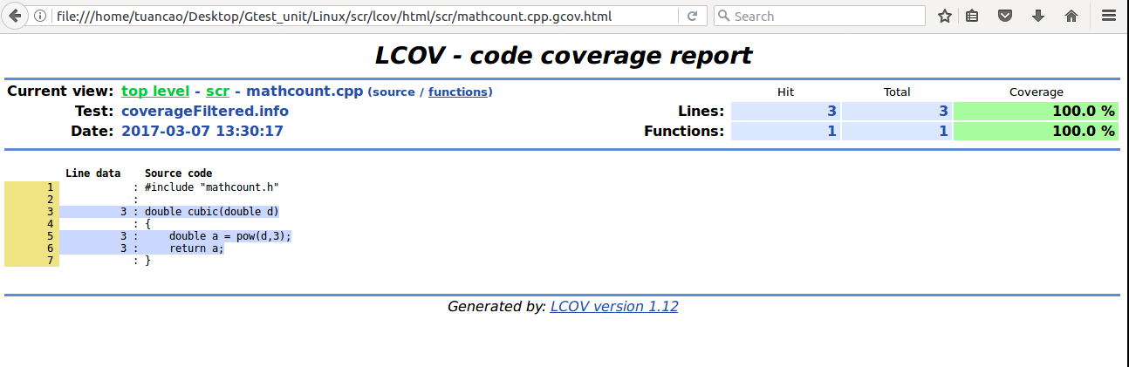
V. TEST CODE COVERAGE
Gcov tool
3. Compile: make run
4. View report

Slide 24
VI. GOOGLE C++ TESTING FRAMEWORK
1. Google C++ overview:
Helps write better C++ tests.
Independent and repeatable.
Portable and reusable.
Fast/Simple to run.
XML test report generation.
Platforms: Linux, Mac OS X, Windows, Cygwin, MinGW, Windows Mobile, Symbian.

Slide 25
VI. GOOGLE C++ TESTING FRAMEWORK
2. Create new project using Google Test
On windows:
Step 1: Download Google Test from
\\IRISDB\share\Unit Testing\Google Test Framework
Step 2: Include gtest-md.vcproj library.
Step 3: Create project need test name: “iribase”.

Slide 26
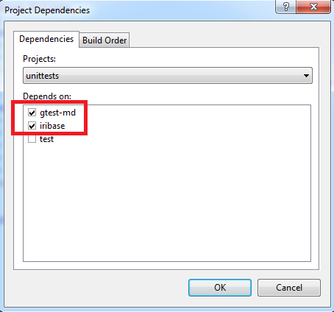
VI. GOOGLE C++ TESTING FRAMEWORK
Step 4: Create project test name: “unittests”.
Check “Project dependencies…

Slide 27
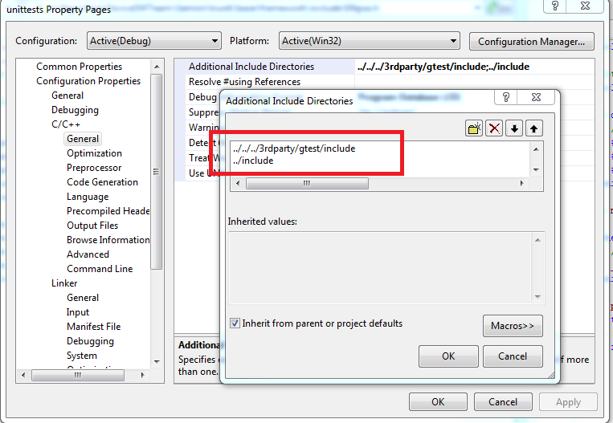
VI. GOOGLE C++ TESTING FRAMEWORK
Additional include Directories

Slide 28
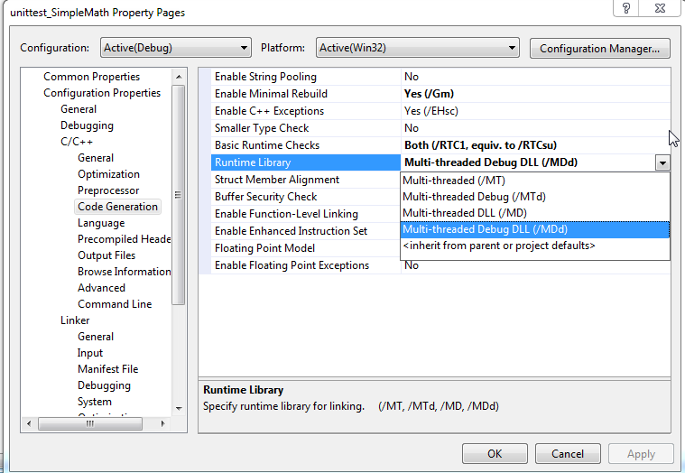
VI. GOOGLE C++ TESTING FRAMEWORK
Select “Runtime library” is “Multi-threaded Debug DLL(/MTd)”

Slide 29
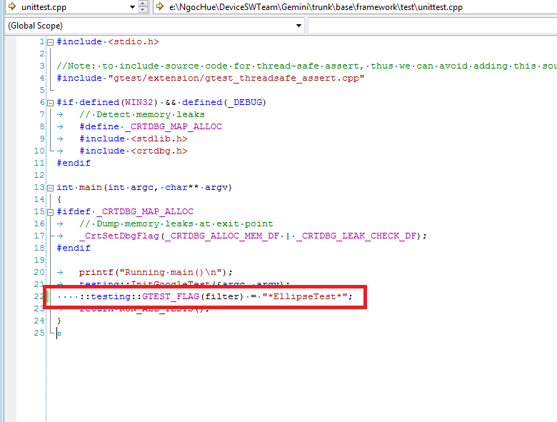
VI. GOOGLE C++ TESTING FRAMEWORK
Step5: Can filter with test suite or test name in main function of file unittests.cpp.

Slide 30
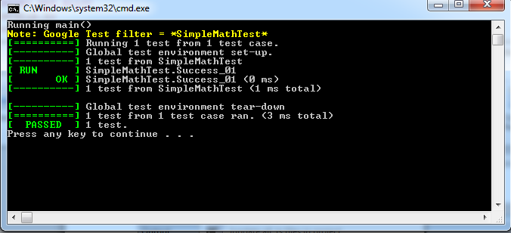
VI. GOOGLE C++ TESTING FRAMEWORK
Step6: Set as Startup project and build project

Slide 31
VI. GOOGLE C++ TESTING FRAMEWORK
2. Create new project using Google Test (cont.)
On Linux
Step 1: Download GoogleTest: gtest-1.7.0.zip
unzip gtest-1.7.0.zip cd gtest-1.7.0 sudo ../ gtest/ build run: cmake ../ to generate “libgtest.a”, “ libgtest main.a” sudo mkdir ../inc folder sudo mkdir ../lib folder sudo mkdir ../src folder sudo mkdir ../test folder copy “libgtest.a”, “ libgtest main.a” to “lib” folder copy gtest from /gtest/include to “inc” folder

Slide 32
VI. GOOGLE C++ TESTING FRAMEWORK
Step 2 : Create GoogleTest Example:
MathCount project:
File src/mathcount.h
File src/mathcount.cpp
Unit test code:
File test/SampleMathTest.cpp
File test/main.cpp
Create Make file for project
File test/Makefile
File test/Makefile.proj

Slide 33
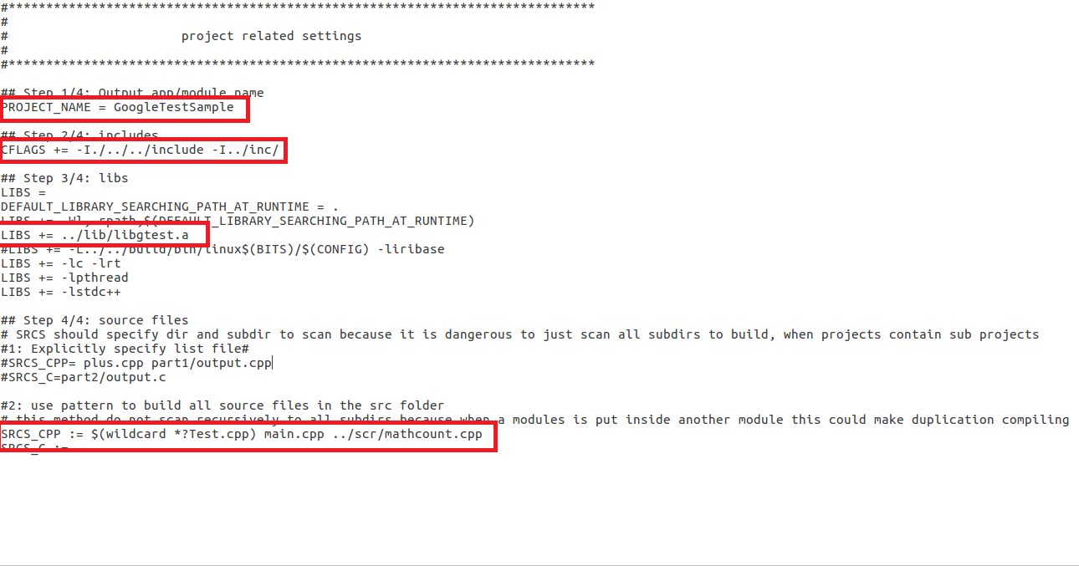
VI. GOOGLE C++ TESTING FRAMEWORK
Step 3: Configuration: test/Makefile.proj

Slide 34
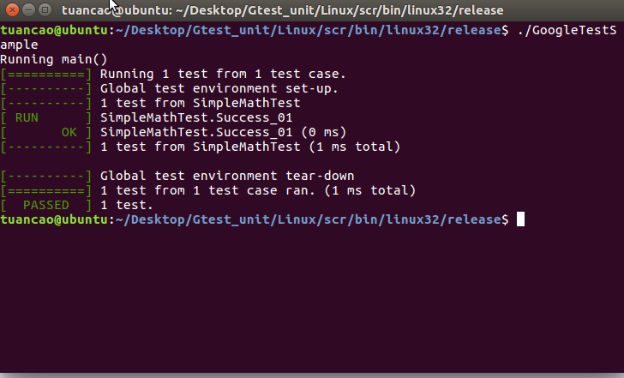
VI. GOOGLE C++ TESTING FRAMEWORK
Step 4: Compile: make
Step 5: Go to “OUTDIR” project in “bin” folder to run “GoogleTestSample.exe” and show result test.

Slide 35
Final
You can view document at:
"\\IRISDB\share\Unit Testing\Unit Testing.docx"
for more detail

